Slide 1
Problem solving with transformations
Transformations

Slide 2
how to use Oak lessons

Slide 3
I can use my knowledge of transformations to solve problems.

Slide 4
A transformation is a process that may change the size, orientation or position of a shape.
The object is the starting figure before a transformation has been applied.
The image is the resulting figure after a transformation has been applied.

Slide 5

Problem solving with transformations
Inverse problems
Perimeter and area
Coordinate problems

Slide 6
Inverse problems
When you want to ‘undo’ adding a number, we use the inverse operation and subtract the number. This returns the starting number.
E.g.
125 + 32 = 157
157 - 32 = 125

Slide 7
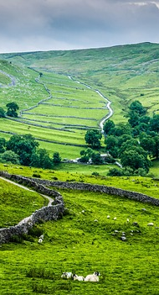
Inverse problems
If the framed photo is moved to the right.
How would you return it to its original position?
Move it the same distance but to the left.

Slide 8
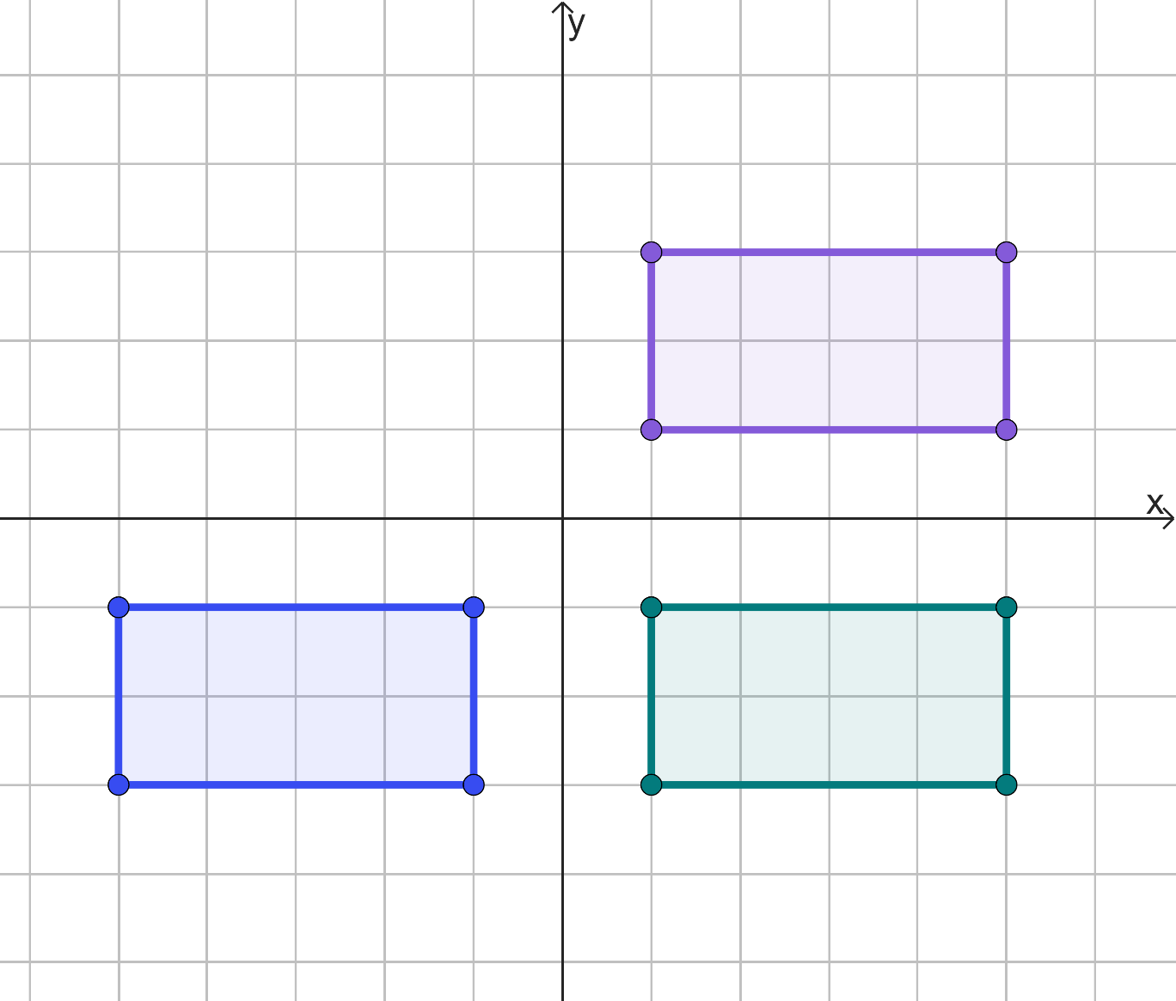



Inverse problems
Rectangle A is reflected in the x-axis to become rectangle B. Rectangle B is then reflected in the y-axis to become rectangle C.
Is there a single transformation that maps rectangle C back onto rectangle A?
A
C
B
Translate rectangle C by
You could rotate 180° about the origin too.

Slide 9
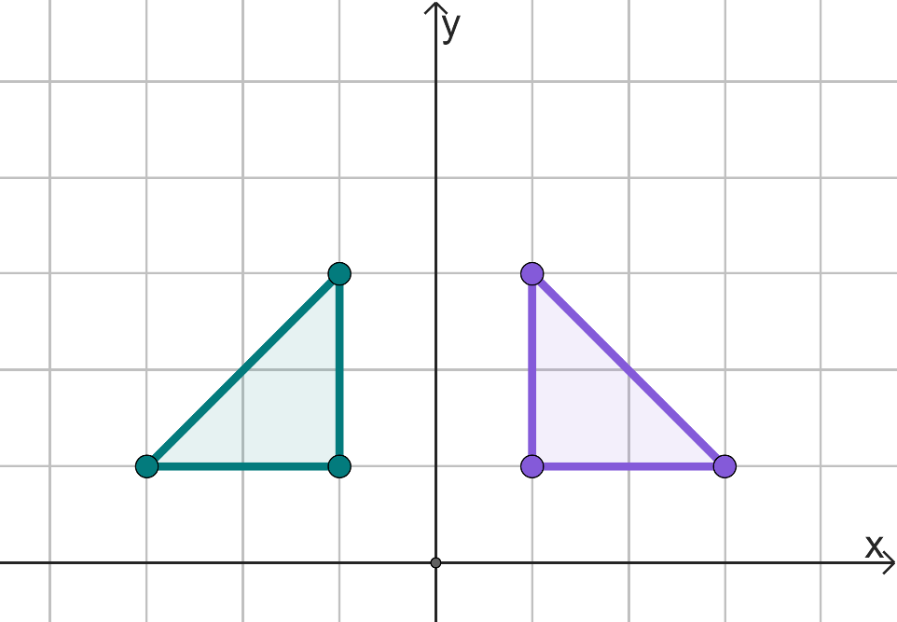
Inverse problems
Triangle A has been rotated 90° anticlockwise about the origin. The image is labelled B.
Complete the two transformations that would map triangle B back onto triangle A.
Rotation of ° clockwise about dddddddd.
in the .
90
(0, 0)
B
A
Reflection
y-axis

Slide 10

Inverse problems
Shape M is translated by to create shape N. What vector would translate shape N onto shape M?
Shape P is reflected in the x-axis to create shape Q. What transformation would map shape Q back on to shape P?
Shape R is enlarged by a scale factor of 4 from the origin. What enlargement scale factor would be needed to map back to shape R?

Slide 11
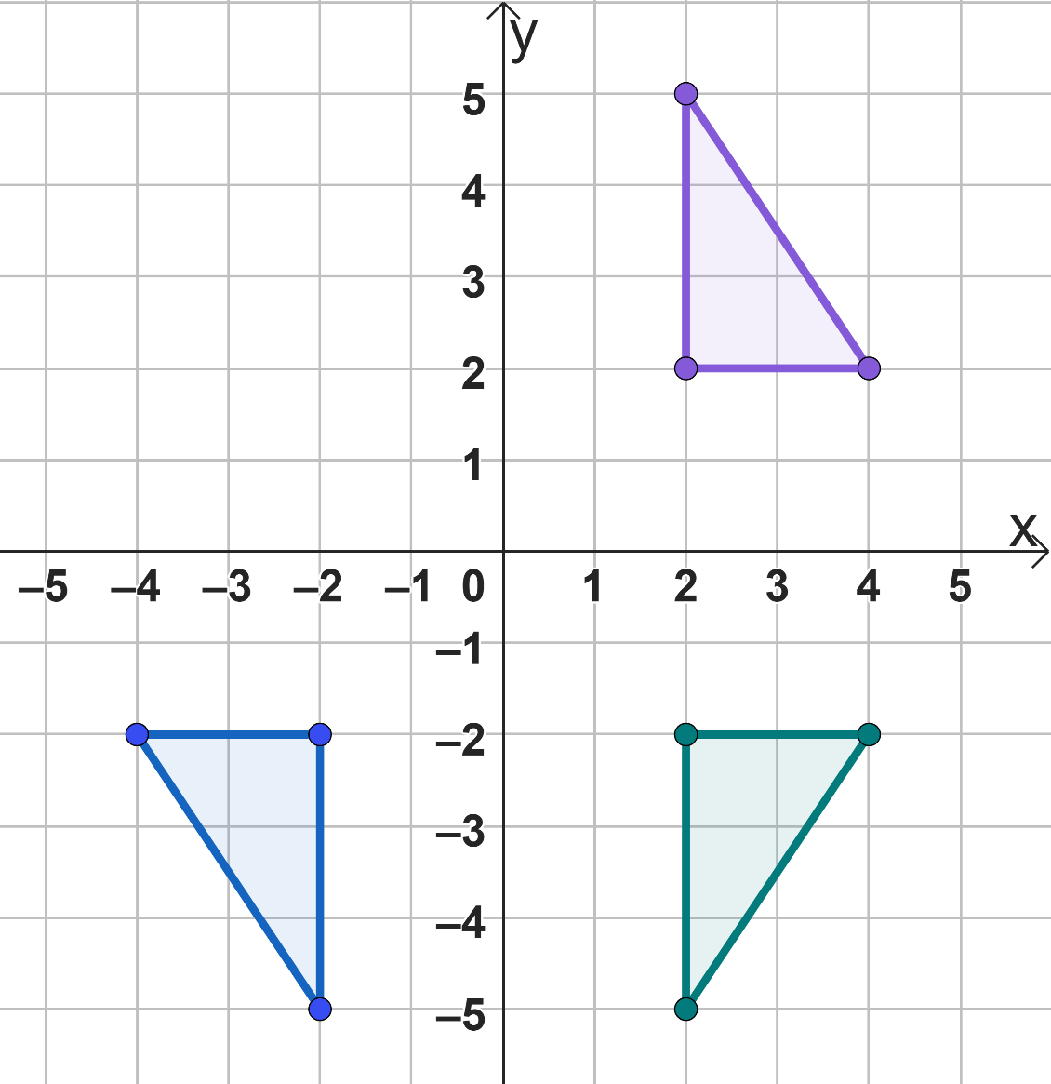
Inverse problems
Shape A is reflected in the x-axis to become shape B. Shape B is then reflected in the y-axis to become shape C.
Fully describe a single transformation that can map shape C onto shape A.
A
C
B

Slide 12
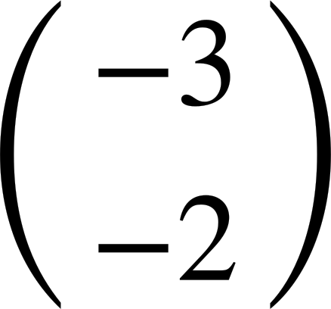
Inverse problems
Shape M is translated by to create shape N. What vector would translate shape N onto shape M?
Shape P is reflected in the x-axis to create shape Q. What transformation would map shape Q back on to shape P?
Reflection in the x-axis. (Depending on shape P it could be a translation or rotation as well).

Slide 13

Inverse problems
Shape R is enlarged by a scale factor of 4 from the origin. What enlargement scale factor would be needed to map back to shape R?

Slide 14
Inverse problems
Shape A is reflected in the x-axis to become shape B. Shape B is then reflected in the y-axis to become shape C.
Fully describe a single transformation that can map shape C onto shape A.
A
Rotate shape C 180° about the origin.
C
B

Slide 15
Problem solving with transformations
Inverse problems
Perimeter and area
Coordinate problems

Slide 16
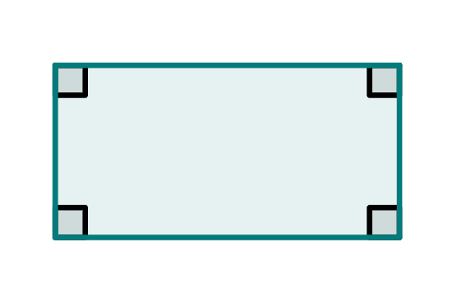
Perimeter and area
The perimeter is the distance around a 2D shape.
Perimeter of this rectangle is 3.7 + 8.2 + 3.7 + 8.2 = 23.8 cm
8.2 cm
3.7 cm
The area states the number of unit squares needed to completely cover that surface.
Area of rectangle = 4 × 8 = 32 cm²

Slide 17
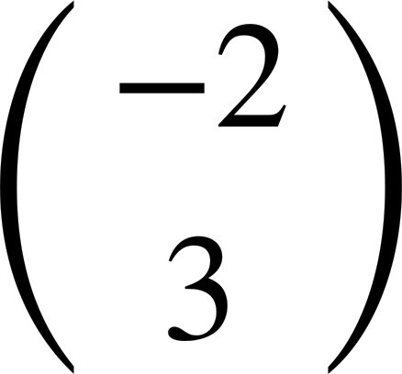
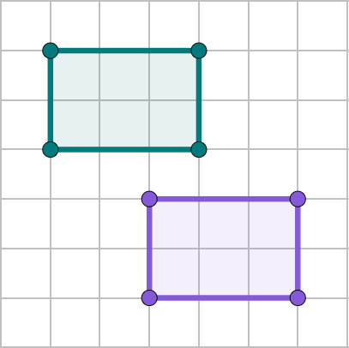
Perimeter and area
Shape A has been translated by to become shape B.
What is the perimeter and area of shape A and shape B respectively?
B
2
3
Perimeter of A = 10 units
Perimeter of B = 10 units
A
2
3
Area of A = 6 square units
Area of B = 6 square units

Slide 18
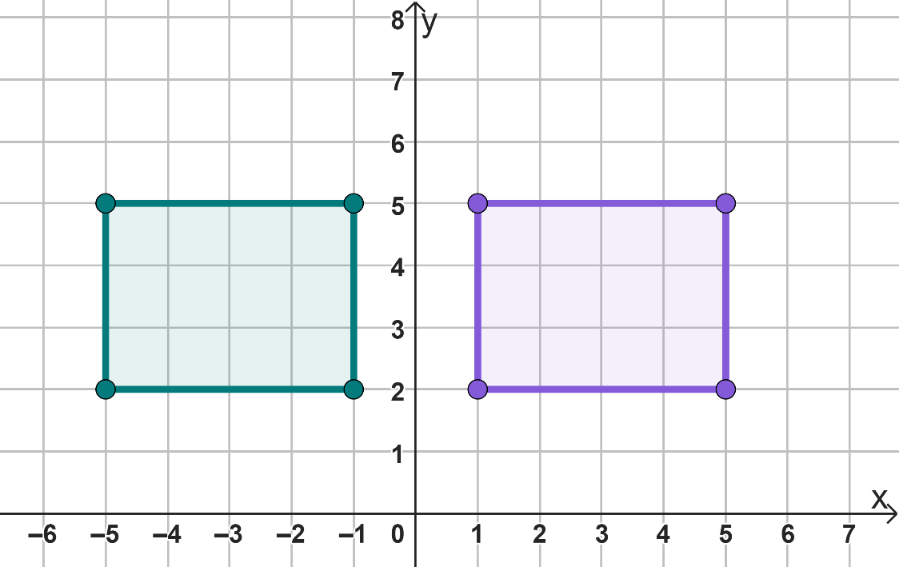
Perimeter and area
Shape C has been reflected in the y-axis to become shape D.
What is the perimeter and area of shape C and shape D respectively?
3
D
C
3
Perimeter of C = 14 units
Perimeter of D = 14 units
4
4
Area of C = 12 square units
Area of D = 12 square units

Slide 19
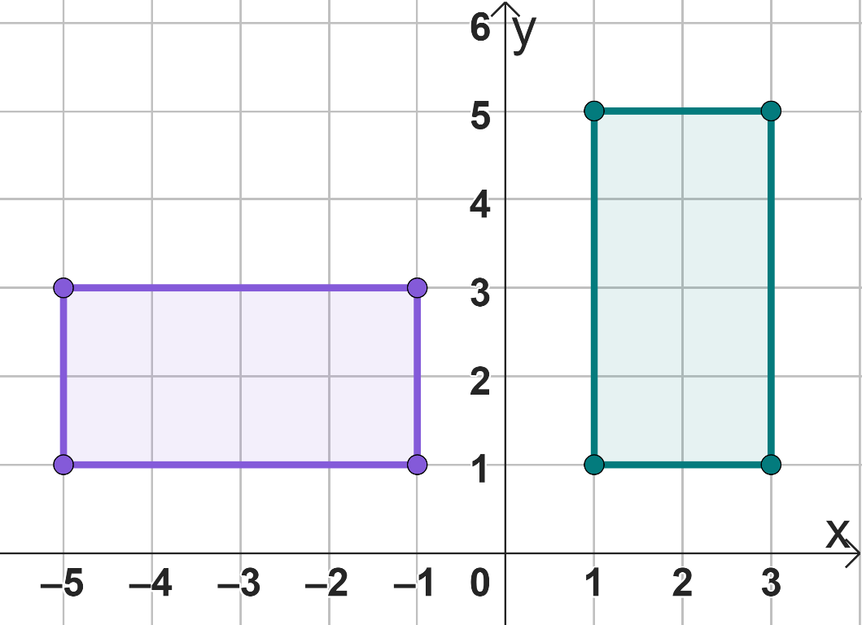

Perimeter and area
Translation and reflection have not changed the perimeter or area.
2
I think this will be the same for rotation as well.
4
F
4
2
E
Lucas
Perimeter of E = 12 units
Perimeter of F = 12 units
Area of E = 8 square units
Area of F = 8 square units

Slide 20
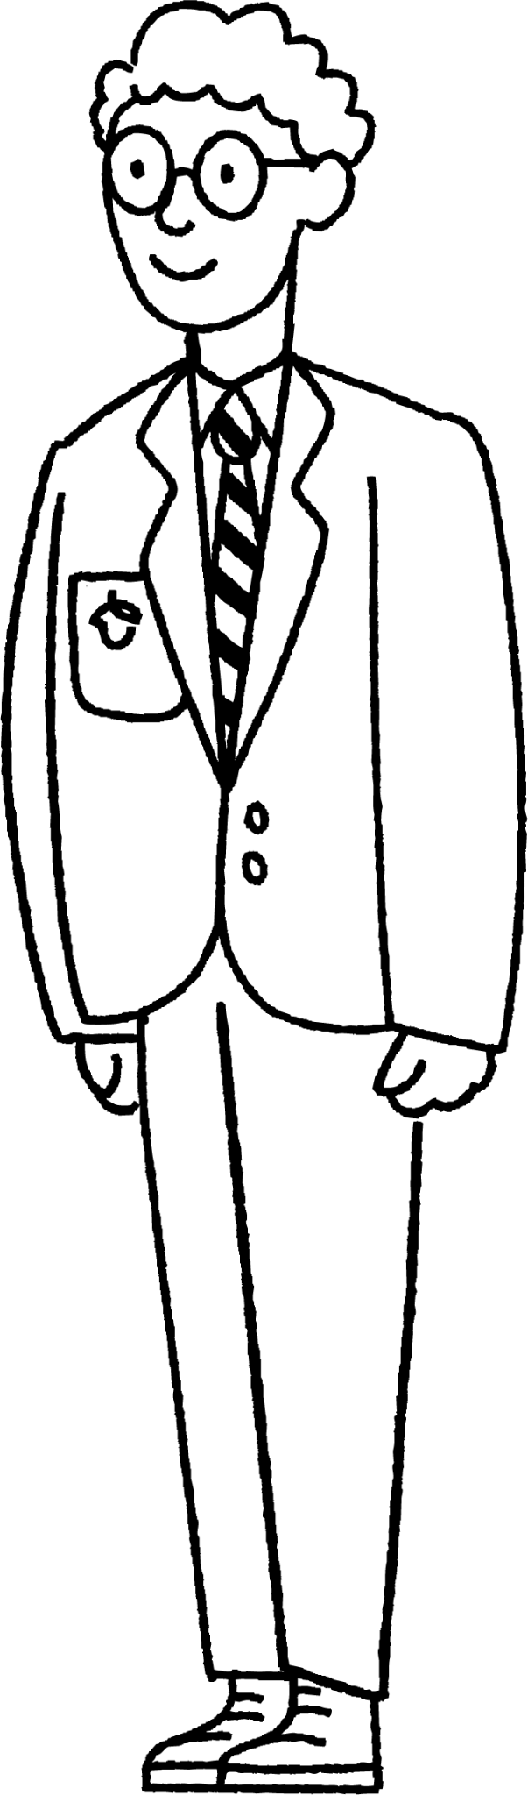
Perimeter and area
So the area would not change either.
Translation, reflection and rotation maintain the lengths, so the perimeter is unchanged.
Lucas
Alex

Slide 21

Perimeter and area
If a shape with perimeter 52 mm is rotated, the image will have the same perimeter.
Rotation maintains length
The lengths have changed position

Slide 22
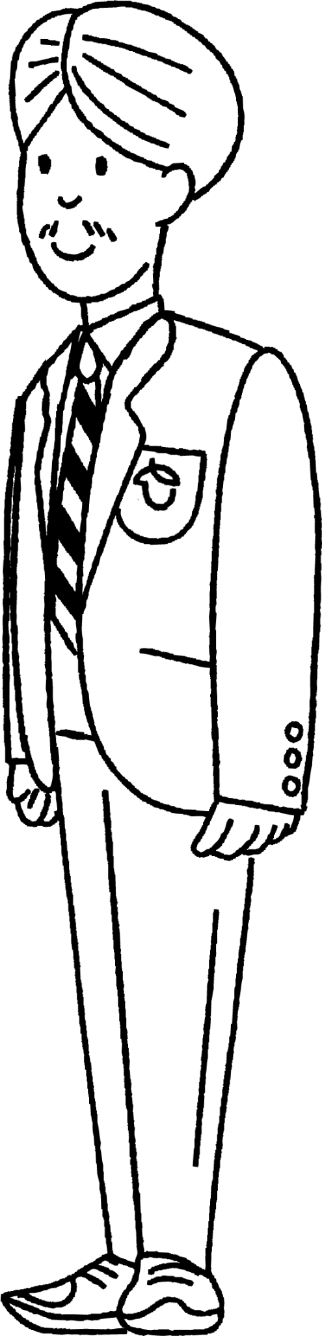

Perimeter and area
The lengths are not maintained as the image is not congruent, so I think they must change.
What about enlargement - does it change perimeter and area?
Aisha
Andeep

Slide 23
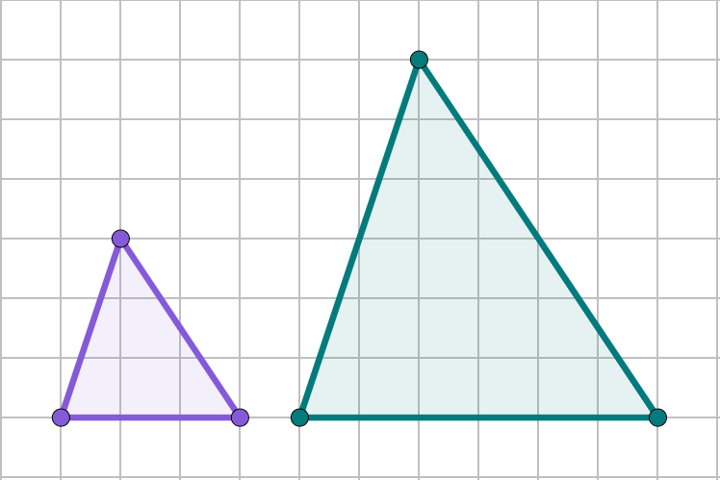

Perimeter and area
Shape H has been enlarged by a scale factor of 2 to become shape I.
Perimeter of H = 9.8 cm
Perimeter of I = 19.6 cm
6.4 cm
7.2 cm
The perimeter of I is twice the perimeter of H, because the scale factor is 2.
3.6 cm
I
3.2 cm
H
3 cm
6 cm
Jun

Slide 24

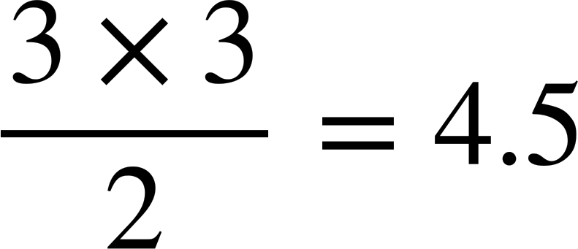
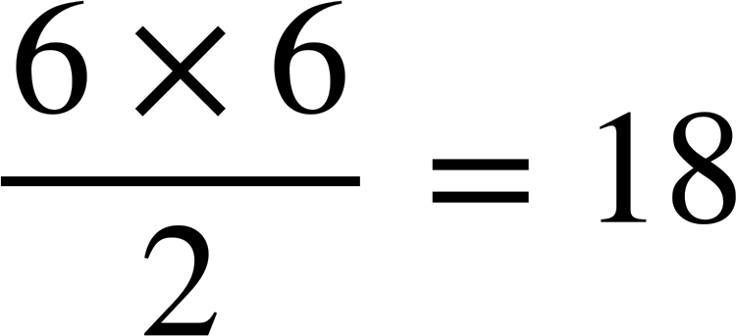
Perimeter and area
So the area will be double as well.
I
H
Alex
6 cm
3 cm
Area of H = cm²
3 cm
6 cm
Area of I = cm²

Slide 25
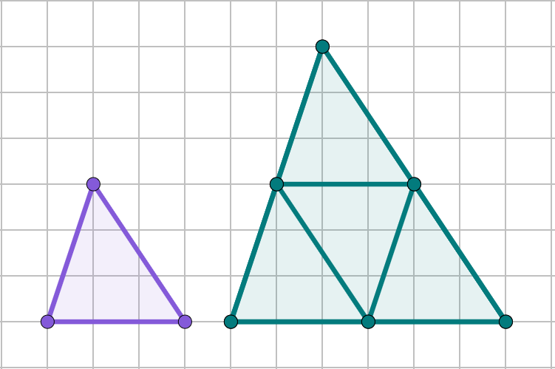
Perimeter and area
The area of the image is four times larger than the object, as it fits four times within the image.

Slide 26
Perimeter and area
Fill the blanks in the following sentences.
When an enlargement takes place, the perimeter asgaggah .
If the enlargement scale factor is 3, the perimeter would be times as long.
The changes but not by the scale factor.
changes
3
area

Slide 27
Perimeter and area
1) A shape has a perimeter of 10 cm.
a) If it is translated its perimeter would be cm.
b) If it is rotated its perimeter would be cm.
c) If it is reflected its perimeter would be cm.
d) If it is enlarged by scale factor 0.5, its perimeter would be cm.

Slide 28
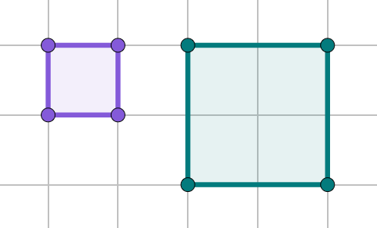
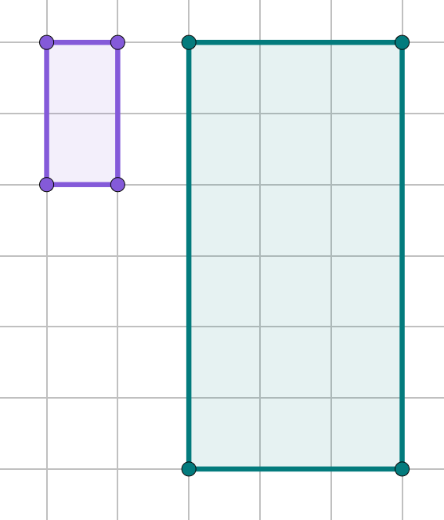
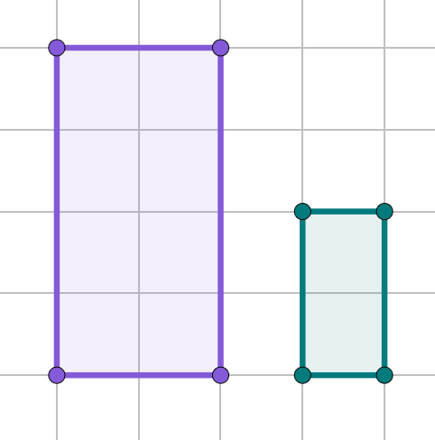
Perimeter and area
2) Work out the perimeter and area of both the object and image in the following enlargements. (Side of 1 square = 1 cm.)
a)
b)
c)
A
A
B
B
A
B

Slide 29
Perimeter and area
1) A shape has a perimeter of 10 cm.
a) If it is translated its perimeter would be 10 cm.
b) If it is rotated its perimeter would be 10 cm.
c) If it is reflected its perimeter would be 10 cm.
d) If it is enlarged by scale factor 0.5, its perimeter would be 5 cm.

Slide 30
Perimeter and area
Work out the perimeter and area of the object and image in the following enlargements. Use 1 square = 1 cm.
a)
b)
c)
A
A
B
B
A
B
Perimeter (A)= 4 cm
Area (A) = 1 cm²
Perimeter (B) = 8 cm
Area (B) = 4 cm²
Perimeter (A)= 6 cm
Area (A) = 2 cm²
Perimeter (B) = 18 cm
Area (B) = 18 cm²
Perimeter (A)= 12 cm
Area (A) = 8 cm²
Perimeter (B) = 6 cm
Area (B) = 2 cm²

Slide 31
Problem solving with transformations
Inverse problems
Perimeter and area
Coordinate problems

Slide 32
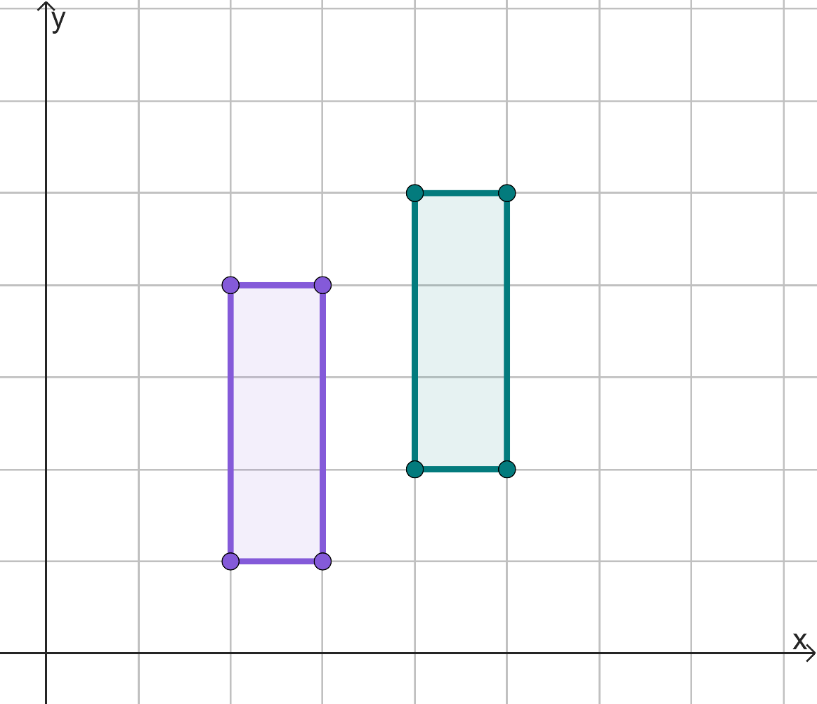

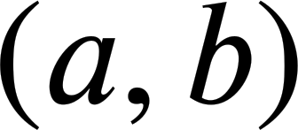

Coordinate problems
The rectangle is translated by .
What would the image of the point be?

Slide 33
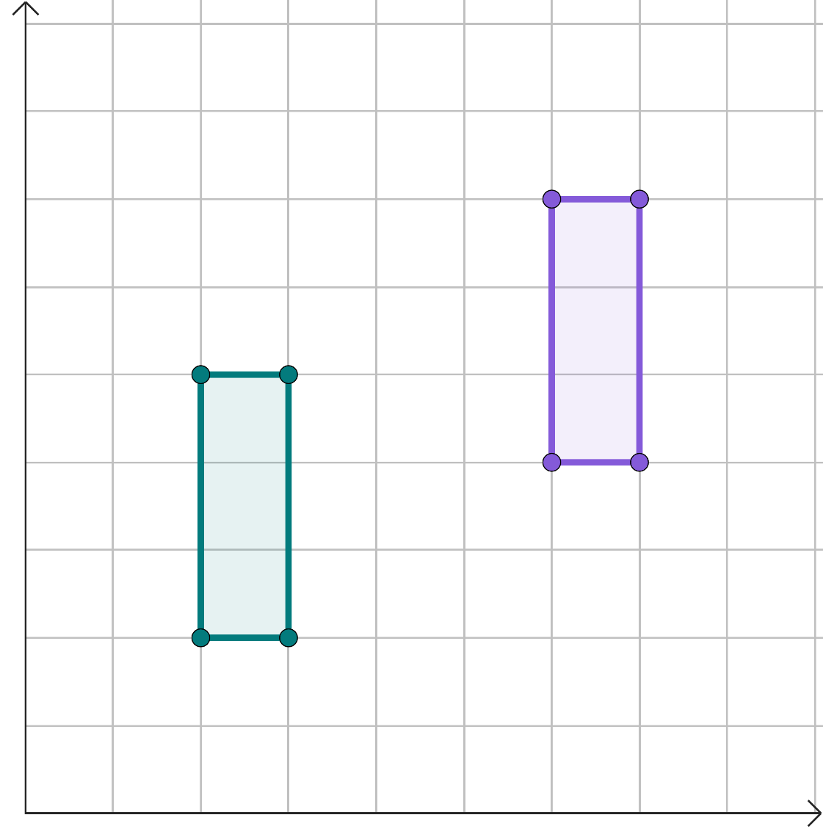
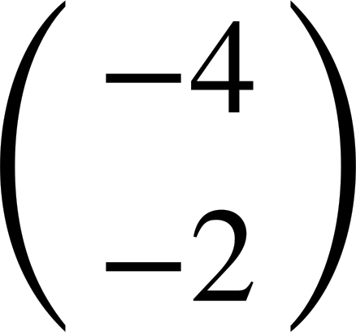
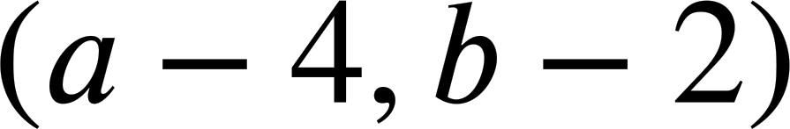
Coordinate problems
The rectangle is translated by .
What would the image of the point (a, b) be?

Slide 34
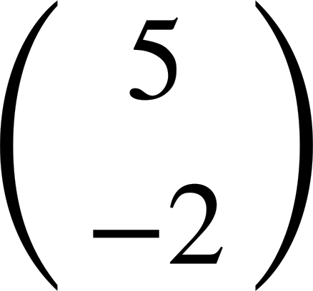
Coordinate problems
A translation has taken place.
By which vector has it been translated?

Slide 35
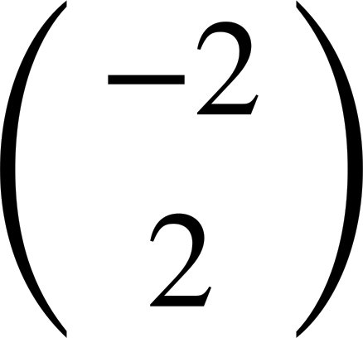
Coordinate problems
A translation has taken place.
By which vector has it been translated?

Slide 36

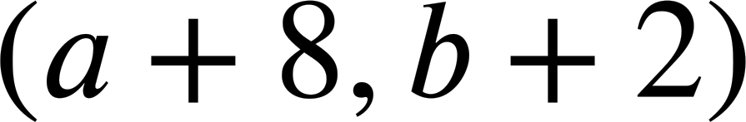

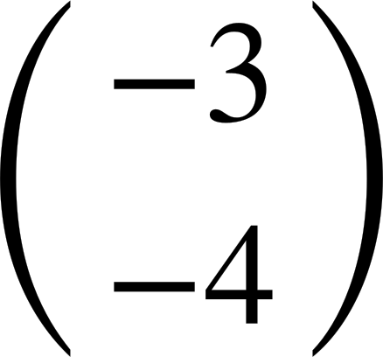

Coordinate problems
translates to . By which vector has it translated by?

Slide 37

Coordinate problems
A triangle with vertices A(3, 4), B(5, 4) and C(5, 9) is transformed.
The image vertices are A′(-3, 4), B′(-5, 4) and C′(-5, 9).
What transformation has taken place?
The x-coordinates are negative, so on the other side of the y-axis.
None of the y-coordinates have changed.
Jun
Jacob

Slide 38
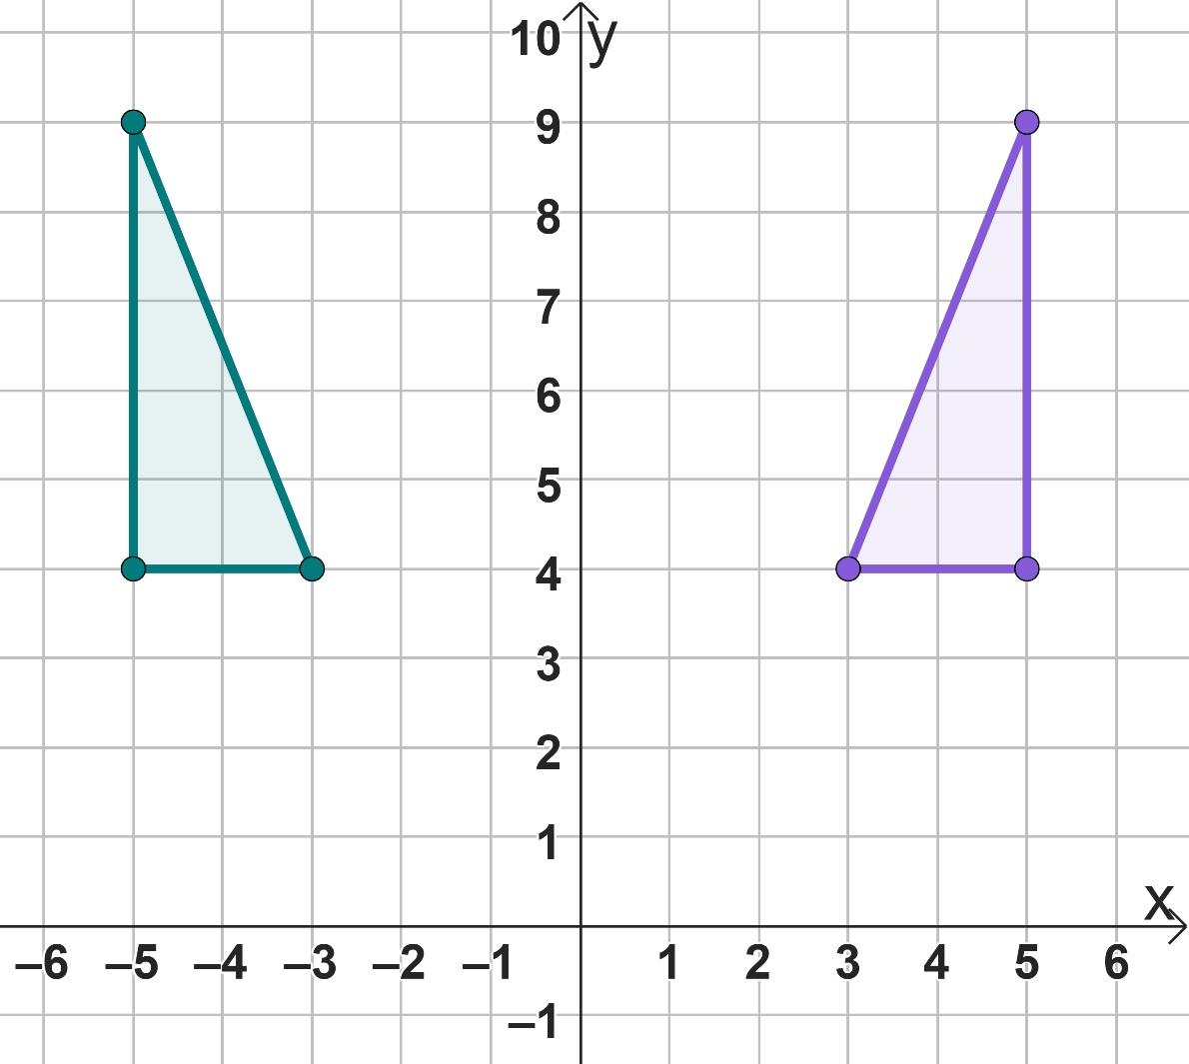
Coordinate problems
A triangle with vertices A(3, 4), B(5, 4) and C(5, 9) is transformed.
The image vertices are A′(-3, 4), B′(-5, 4) and C′(-5, 9).
What transformation has taken place?
A reflection in the y-axis.

Slide 39
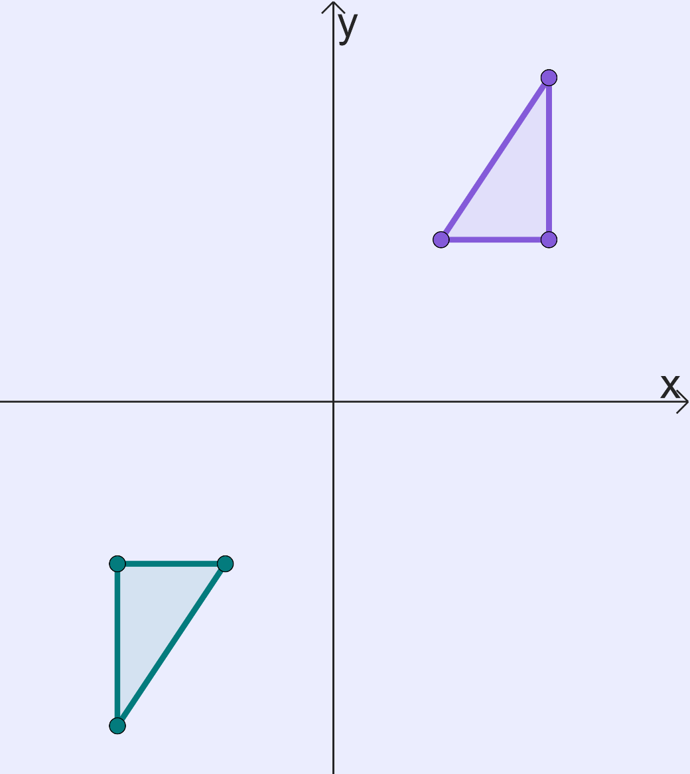
Coordinate problems
A rotation by 180° about the origin has occurred.
Fill the missing coordinate.
(4, 6)
(2, 3)
(4, 3)
(-4, -3)
(-2, -3)
-4
-6
( , )

Slide 40
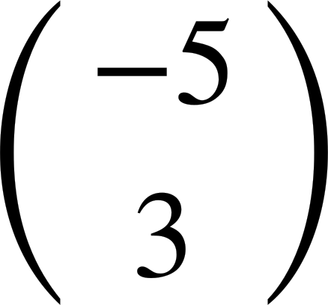


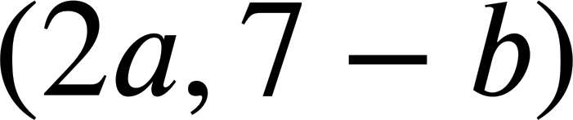

Coordinate problems
The following points have been translated by Write the coordinate of the image.
a)
b)
c)
d)
e)

Slide 41
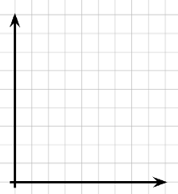
Coordinate problems
If these are the coordinates for the vertices, what transformation has occurred?
Object: A(1,4) B(1,1) C(2,1) Image: A′(4,4) B′(4,1) C′(5,1)
b)
Object: A(1,4) B(1,1) C(2,1) Image: A′(1,4) B′(1,7) C′(2,7)
You may wish to plot the coordinates.

Slide 42
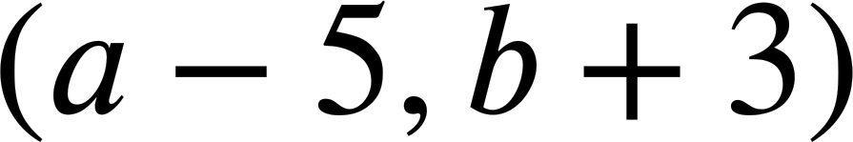


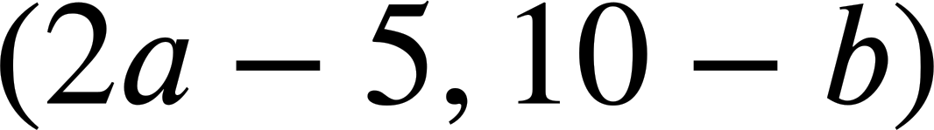

Coordinate problems
The following points have been translated by Write the coordinate of the image.
a)
b)
c)
d)
e)

Slide 43
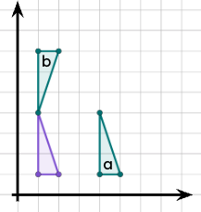

Coordinate problems
If these are the coordinates for the vertices, what transformation has occurred?
Object: A(1,4) B(1,1) C(2,1) Image: A′(4,4) B′(4,1) C′(5,1)
Translated by
b)
Object: A(1,4) B(1,1) C(2,1) Image: A′(1,4) B′(1,7) C′(2,7)
Reflected in a horizontal line.

Slide 44
Problem solving with transformations
Knowing what changes and what is invariant in each of the transformations helps when solving problems.
Completing the transformation or sketching it can really help in order to solve problems.

Slide 45

© Oak National Academy 2023.
Produced in partnership with Mathematics in Education and Industry.
Licensed on the Open Government Licence v3.0, except where otherwise stated. See Oak terms and conditions.

